Slide 1
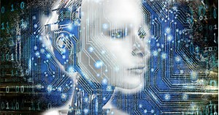
Artificial intelligence - Machine Learning and Compliance. ULM – March 28,2019
Or How I lost my Job to a Robot!

Slide 2
Topics for Today
What is AI or Machine learning.
AI Basics AI Learning Model
AI based Security Testing
Q & A

Slide 3
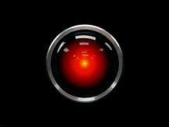


Slide 4
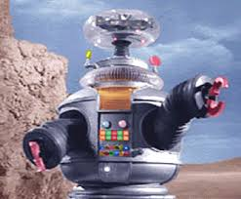
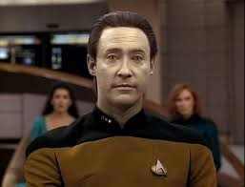
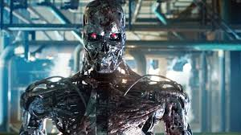
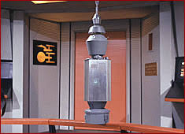
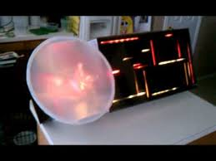
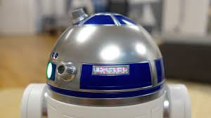
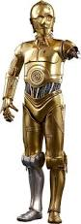
Or is this AI from Science Fiction to Science Fact ?

Slide 5
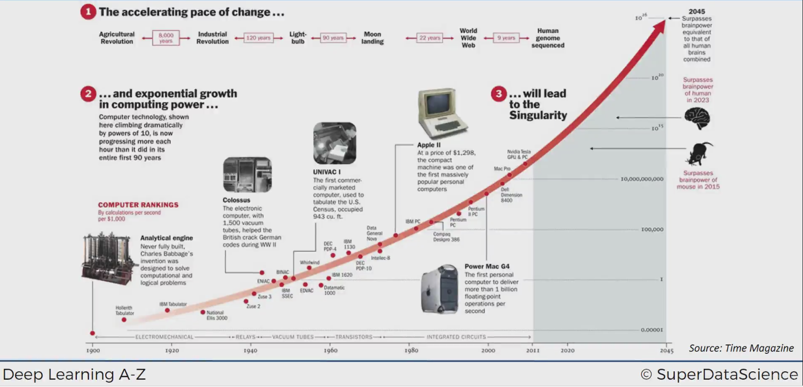

Slide 6
What is AI or Machine learning.

Slide 7
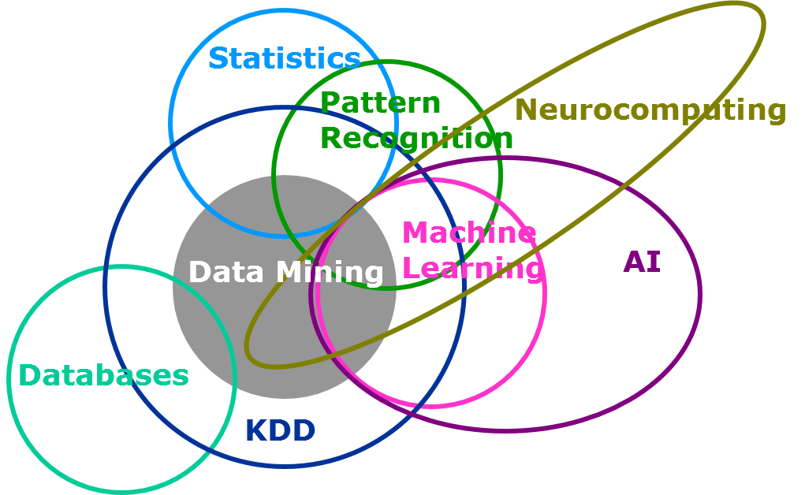

Slide 8
What is Artificial Intelligence?
From Merriam Webster:
1. A branch of computer science dealing with the simulation of intelligent behavior in computers
2. The capability of a machine to imitate intelligent human behavior
From Wikipedia:
Artificial intelligence (AI, also machine intelligence, MI) is Intelligence displayed by machines, in contrast with the natural intelligence (NI) displayed by humans and other animals. In computer science AI research is defined as the study of "intelligent agents": any device that perceives its environment and takes actions that maximize its chance of success at some goal.^{[1]}Colloquially, the term "artificial intelligence" is applied when a machine mimics "cognitive" functions that humans associate with other human minds, such as "learning" and "problem solving".[

Slide 9
The World of Artificial Intelligence (AI)
Artificial Intelligence | 1950
Machine learning | 1980
Search Methods
Recommendation
Artificial Neural Networks “Deep learning” | 2010
Decision Trees
Bayesion Models
Optimization Method
Language Processing
Convolutional
Regression
Evolutionary Computation
A subset of ML which makes the computation of multi-layer neural networks feasible
Recurrent
Logic
Perception
Support Vector Machines
Swarm Intelligence
Multi-Layered Perceptron
Planning
Robotics
Nearest Neighbor
Reinforcement Learning
Probabilistic Reasoning
Expert Systems

Slide 10
Statistical Learning
Machine Learning
Model
Parameters
Fitting
Test set performance
Regression Classficiation
Density estimation, clustering
Network, graphs
Weights
Learning
Generalization
Supervised Learning
Unsupervised Learning

Slide 11
Statistical Learning
Been around for Hundreds of Years
Ability for Humans and Animals to extract statistical regularities from the the world around them to learn about the environment.
A subfield of mathematics which deals with finding relationship between variables to predict an outcome.
Examples – Regression, Linear Regresision.

Slide 12
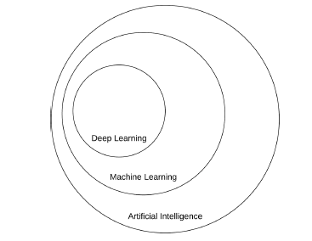
What is AI vs Machine Learning vs Deeping Learning?

Slide 13
Machine Learning – Predicting the future or outcomes
Ability of a machine to improve its own performance through the use of a software that employs artificial intelligence techniques to mimic the ways by which humans seem to learn, such as repetition and experience
A subfield of computer science and artificial intelligence which deals with building systems that can learn from data, instead of explicitly programmed instructions.
Example:
Regression - In regression problem the goal of the algorithm is to predict real-valued output.
Predict value from Observations
Predicted values are continuous
Linear Regression is made with an assumption that there’s a linear relationship between X and Y.
Oldest and mostly widely used predictive model.

Slide 14
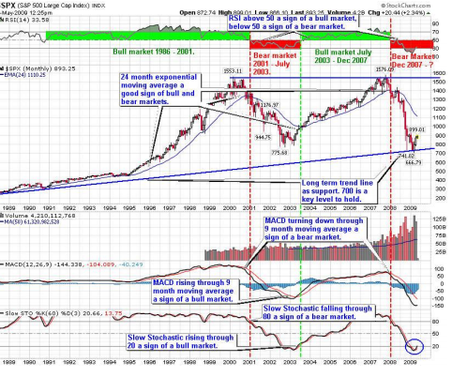
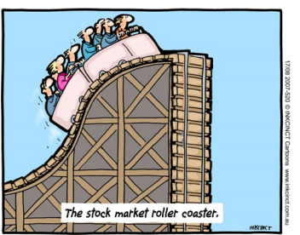
Financial Applications
Stock market time series forecasting.
Buy/sell timing detection and stock portfolio selection.

Slide 15
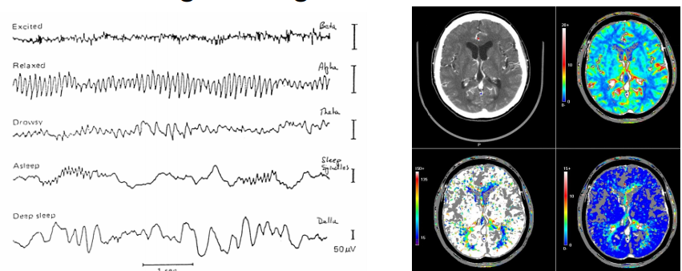
Medical Applications
EEG/ECG processing – e.g. sleep disorder
Survival analysis – e.g. breast cancer
Pattern/Image recognition – MR, CT

Slide 16
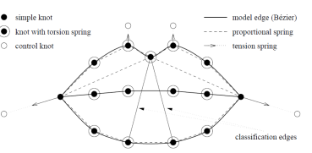
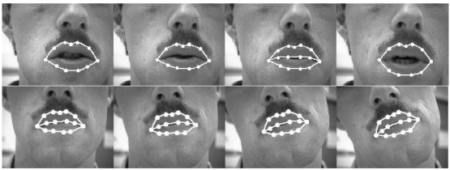
Speechreading
Günter Mamier, Marco Sommerau & Michael Vogt, Universität Stuttgart.
A neural classifier detects visibility of teeth edges and other attributes.

Slide 17
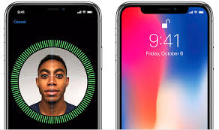
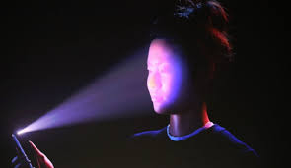
Neural Network – Facial Recognition

Slide 18
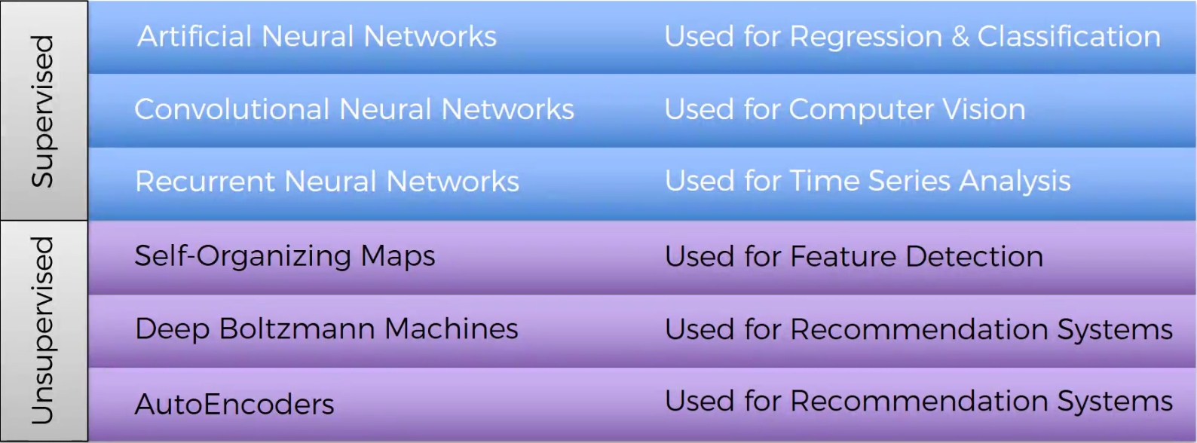
Road Map of AI Networks

Slide 19
Supervised Learning
Unsupervised Learning

Slide 20
How do Machines learn ?
Supervised
Provide specific training sets and data
Is like learning with a teacher
Training dataset is your teacher.
Training set is used to train the machine.
Common Uses
Cortana /Siri or any speech automated system in your mobile phone trains your voice and then starts working based on this training.
Image Recognition – i.e. License Plate numbers

Slide 21
Unsupervised Learning
The model will organized the data based on the features of the data. The algorithm is used to draw inferences from data.
Examples in clustering and reinforcement learning
Very Powerful because it assumes no pre-discovered classification of data
like learning without a teacher
the machine learns through observation & find structures in data
Common Uses
Images
Voting Patterns
Cortana or any speech automated system in your mobile phone trains your voice and then starts working based on this training.

Slide 22
Unsupervised Learning
Caveats -
No outcome variable, just a set of predictors (features) measured on a set of samples.
Objective is more fuzzy — ﬁnd groups of samples that behave similarly, ﬁnd features that behave similarly, ﬁnd linear combinations of features with the most variation.
Diﬃcult to know how well your are doing.
Diﬀerent from supervised learning, but can be useful as a pre-processing step for supervised learning.

Slide 23
Machine Learning
Regression
Simplest form of Supervised Machine Learning

Slide 24
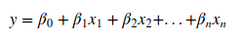
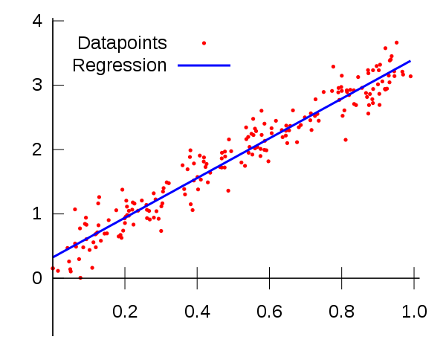
Regression
Simple Linear Regression Problem

Slide 25
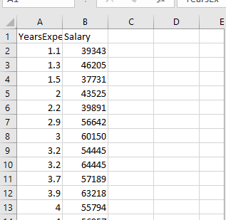
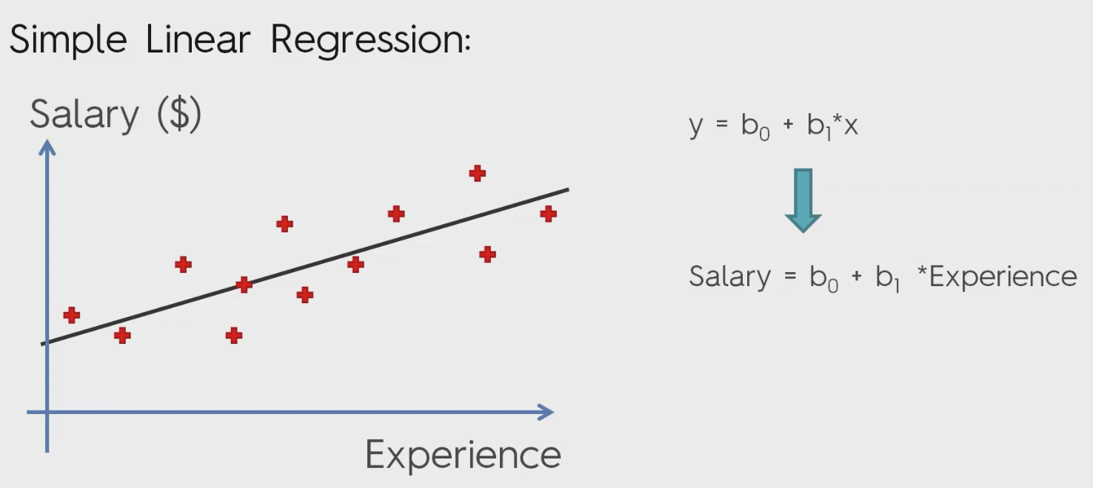
Example Regression – Years of Experience - Salary

Slide 26
Predict Salary based on Year Experience

Slide 27
Machine Learning
Logistic Regression - Classification
Use for Classification
Binary classification
Yes or No – 0 or 1
Examples of Classifications
Classified x-rays as cancerous or not
Qualitive and not Quantitative
Gives the probability of the outcome

Slide 28
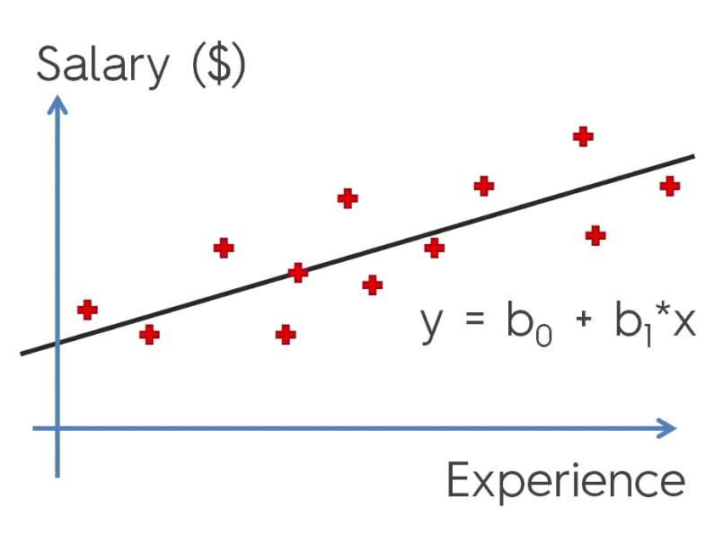
Linear Regression

Slide 29
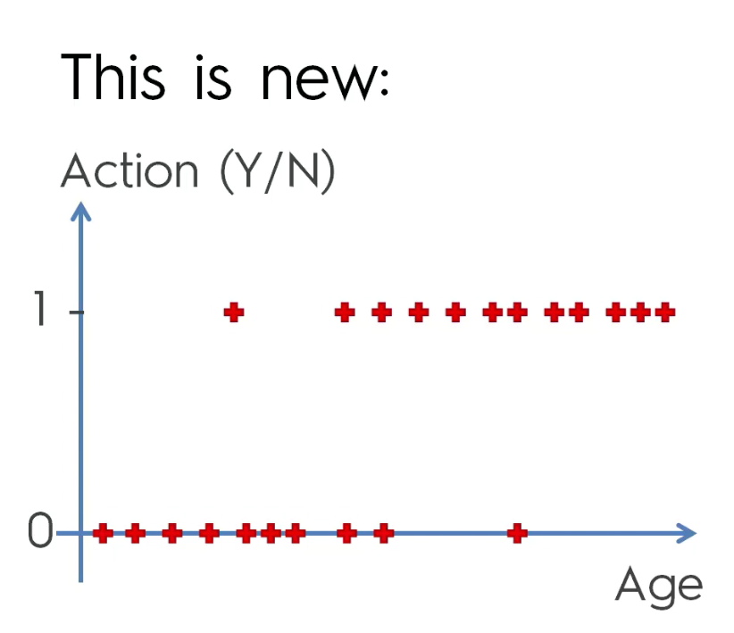

Slide 30
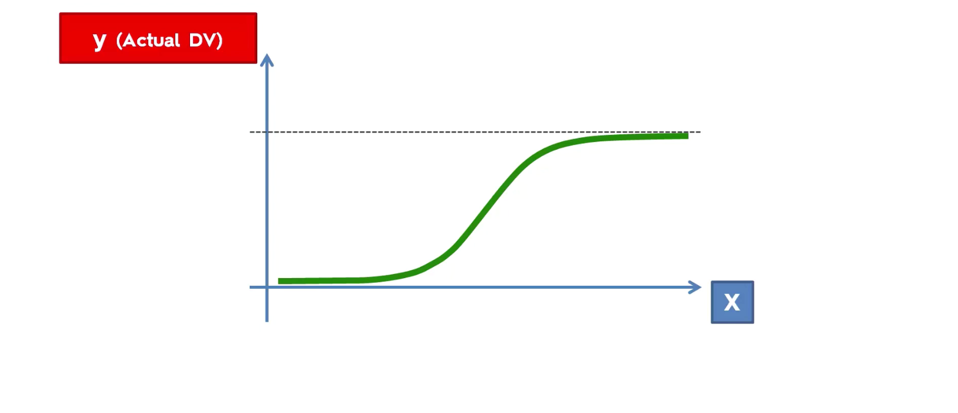
Sigmoid function

Slide 31
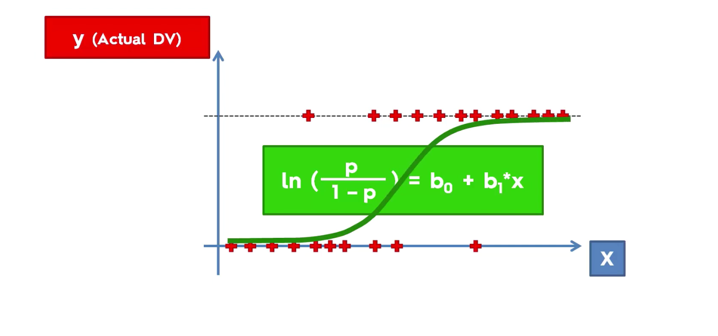

Slide 32
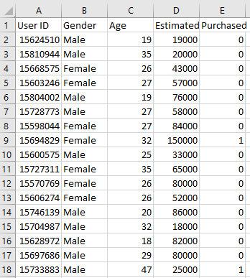
Problem
Solution Logistics Regression Machine Learning
Based on Salaries and Age will a person purchases a Car or not
Data Training Set

Slide 33
Steps
Lab

Slide 34
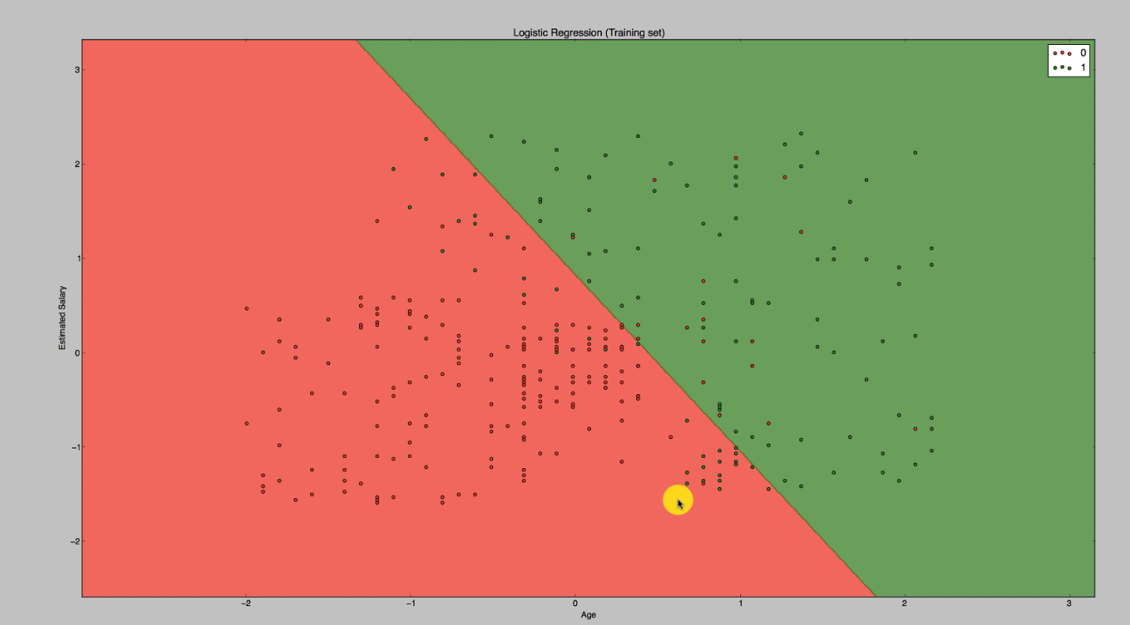

Slide 35
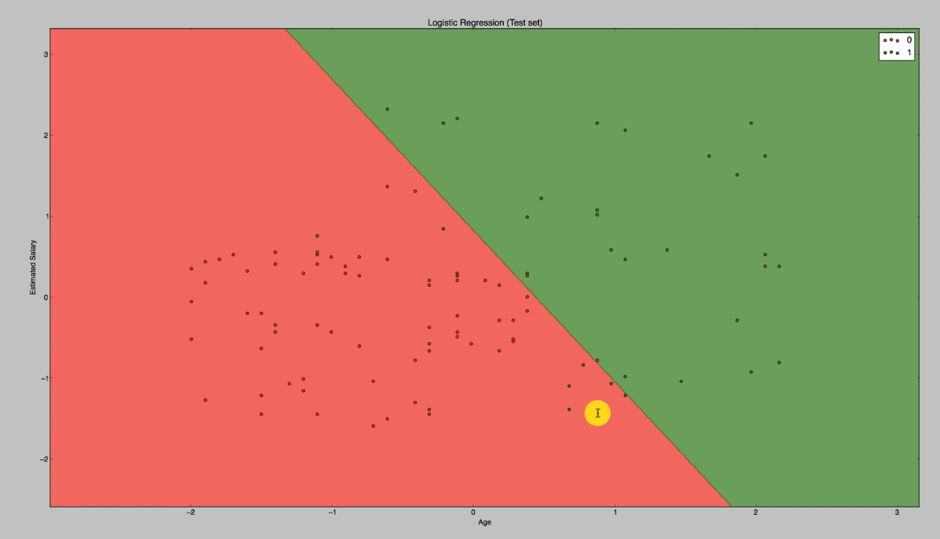
Test Set

Slide 36
DEEP LEARNING
Deep Learning is a subfield of machine learning concerned with algorithms inspired by the structure and function of the brain called artificial neural networks.
Artificial Neural Networks
Convolutional Neural Networks

Slide 37
Neural Networks – A primer
The Neuron
Activation Function
How do Neural Networks Work (Example
How do Neural Networks Learn
Backpropagations
Forward Propagation
Reinforcement Learning

Slide 38
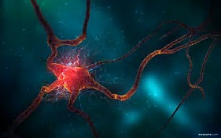
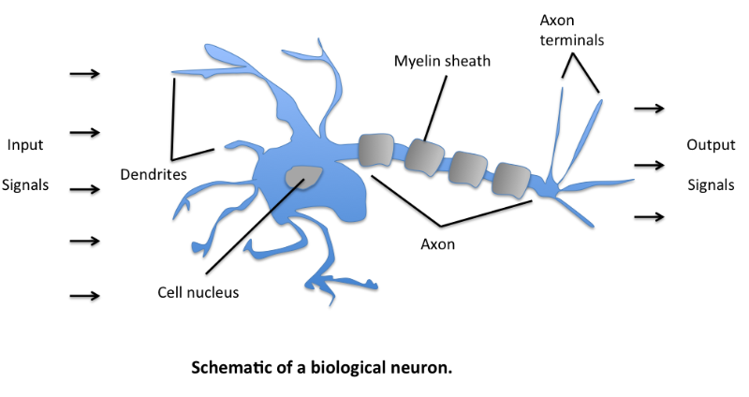
Neuron

Slide 39

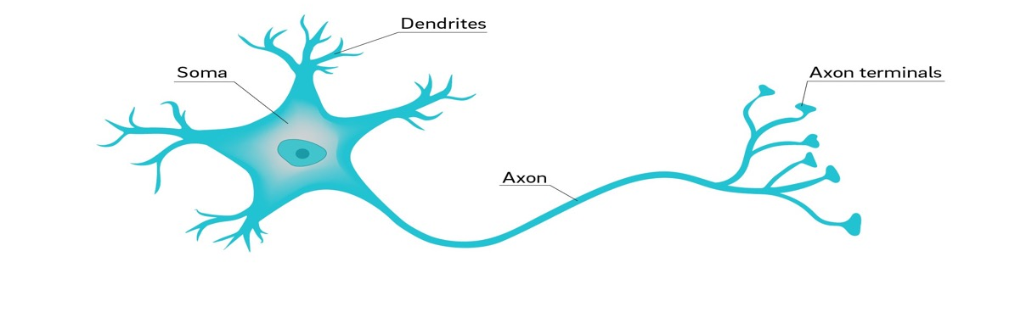
Human brain
Artificial brain
VS.
Billions of neurons connected to each other through synapses
Neuron - electrically excitable cell that receives, processes, and transmits information through electrical and chemical signals
The width of the synapse represent the connection strength between the neurons
Hundreds of thousands of “neurons” connected to each other
The connection strength between “neurons” is represent by weights

Slide 40
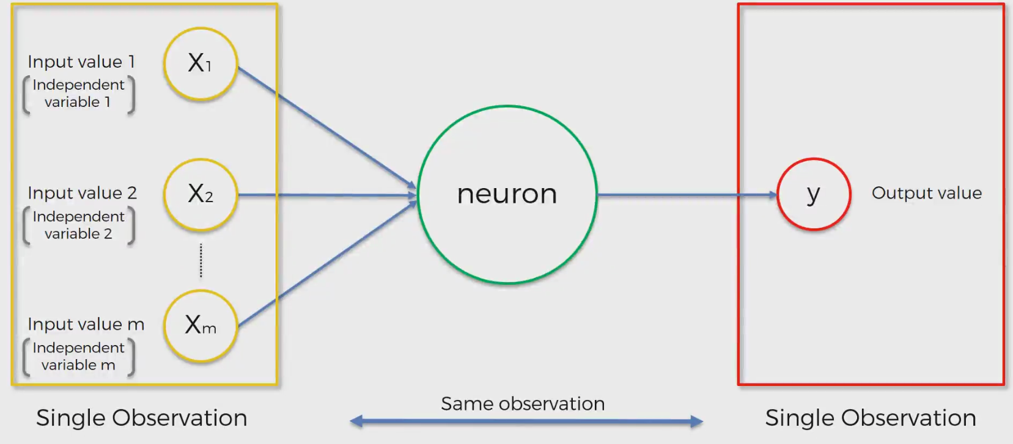

Slide 41
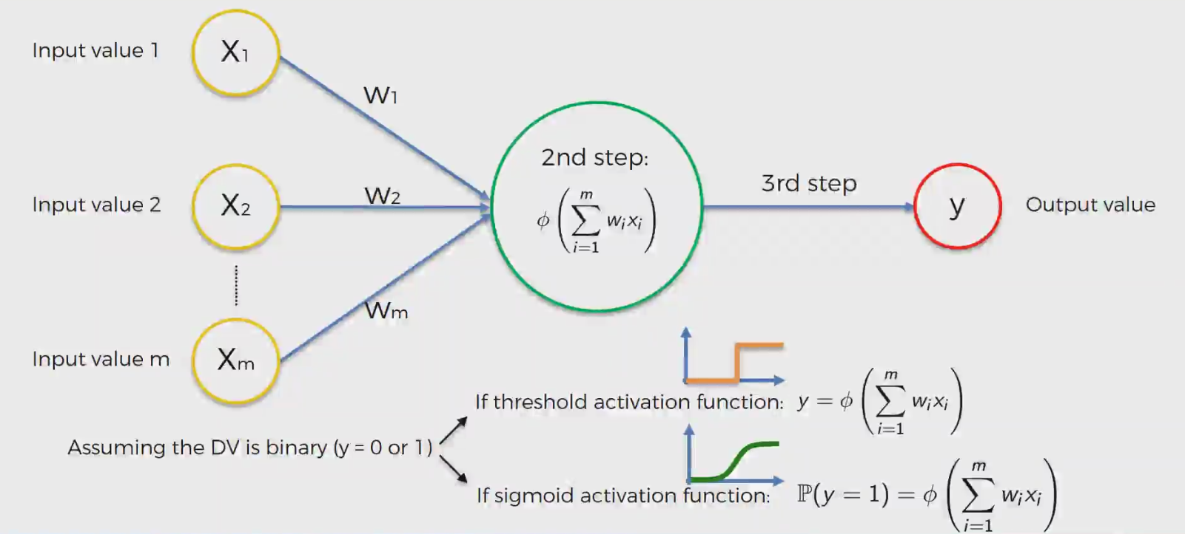
Activation function – Fires the Neuron

Slide 42
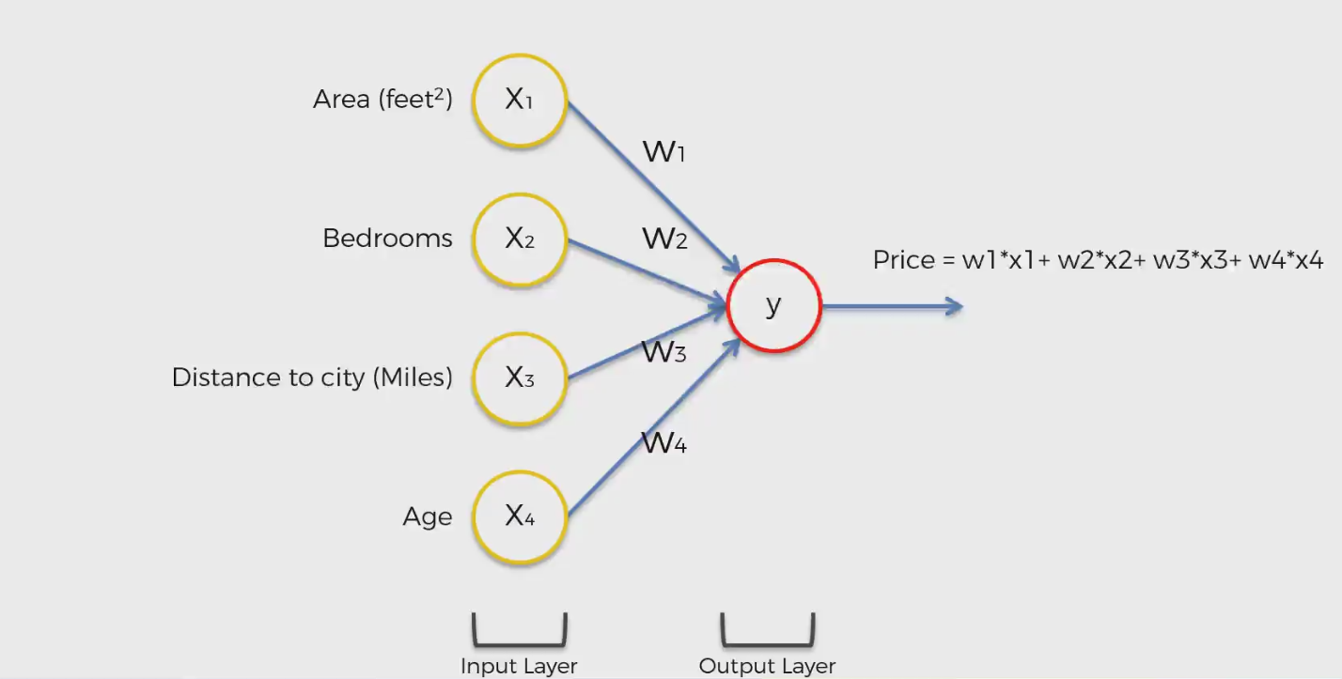
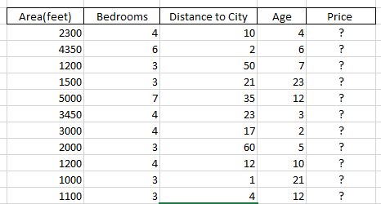
Example – lets Predict the Price of a House based on several factors.

Slide 43
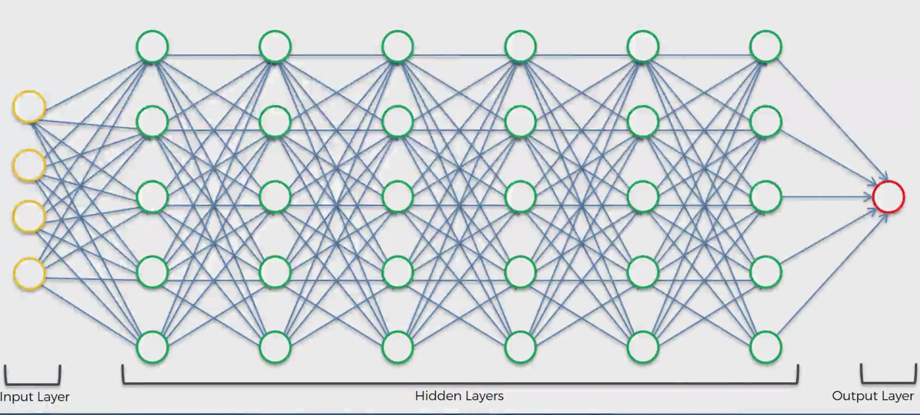
Deep Learning

Slide 44
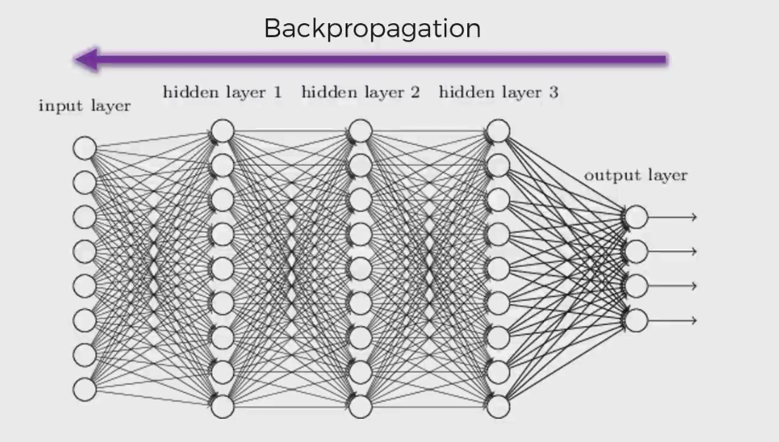
Learning – Back propagation

Slide 45
EFFECT OF MORE NEURONS LAYERS
Malicious
Benign
3 hidden neuron layers
6 hidden neurons layers
20 hidden neurons layers
The more layers, the better the accuracy
Notes:
Deep learning, also known as deep neural network, is based on layers of neurons. Just like our human brain.
Each neuron represent a mathematical formula and the connections between neurons are the weights.
trying to find a classifier or a way to distinguish between bad a good samples.
In this example you can see 2 dimensions, 2 axis that represent a data feature. Now think about millions of dimensions…
The more layers the better the accuracy. But it comes with a price – performance. More layers, the worst the performance will be
There is not formula to calculate the optimum number of layers.
This where the expertise and experience of the deep learning scientists become so important.
But since this a relatively new discipline there are just not of them. And most iof them got to work for the tech giants to earn a lot of money. If I knew, I may have gone to study something else…

Slide 46
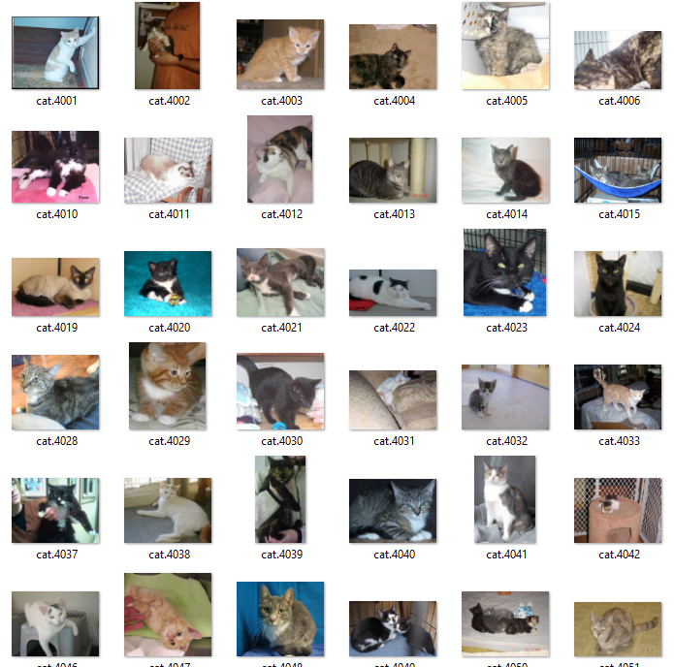
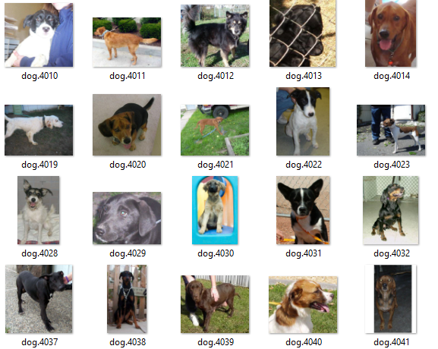
Example of Training a Neural network - Which picture is a dog or a cat ?What Size Training set ???

Slide 47
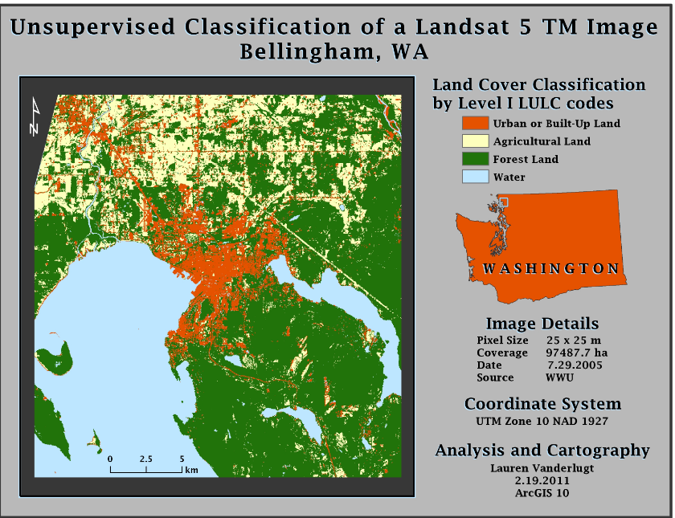
Example – unsupervised classification Landsat Images

Slide 48
Steps
To Build your AI Network
Preprocess the Data
Format the Data
Splitting the Data Set into the Training and Test Set
Feature Scaling
Build the Network
Train the Network
Analysis of Results

Slide 49
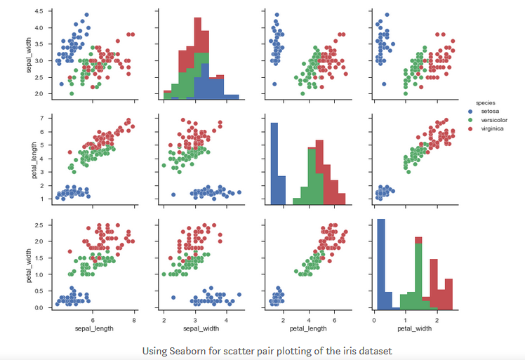
Pre-Process – Visualize the Data
What does the Data Look Like – By viewing this it would give you an idea of potential issues.
Use a Scatter Plot to help visualize the data

Slide 50
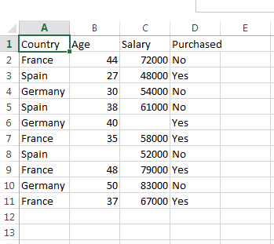
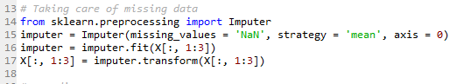
Preprocess the Data
Missing Data
Must validate your data for completeness
Sample the actual data
Common in many real life situations:
Remove the missing data Line – Not recommend
Calculate the missing data – by calculating the mean of the missing data

Slide 51
Encoding Categorical Data
Computer can only Read – ones or Zeroes’
That happens if your have data Element called “Country” as the following potential values
France
Spain
Germany ?

Slide 52
Encoding Categorical Data
Solution – Translation

Slide 53
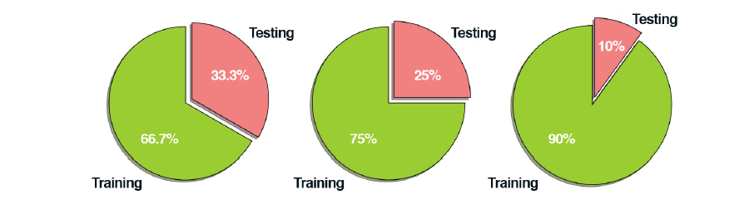
Create the training and test sets

Slide 54
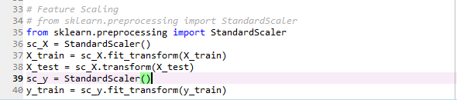
Feature Scaling
I
Scales the Data
Example data range 1 to 1000

Slide 55
Artificial Neural Networks
Lab
Problem - Need to Predict if a Server or Servers are open to Attack

Slide 56
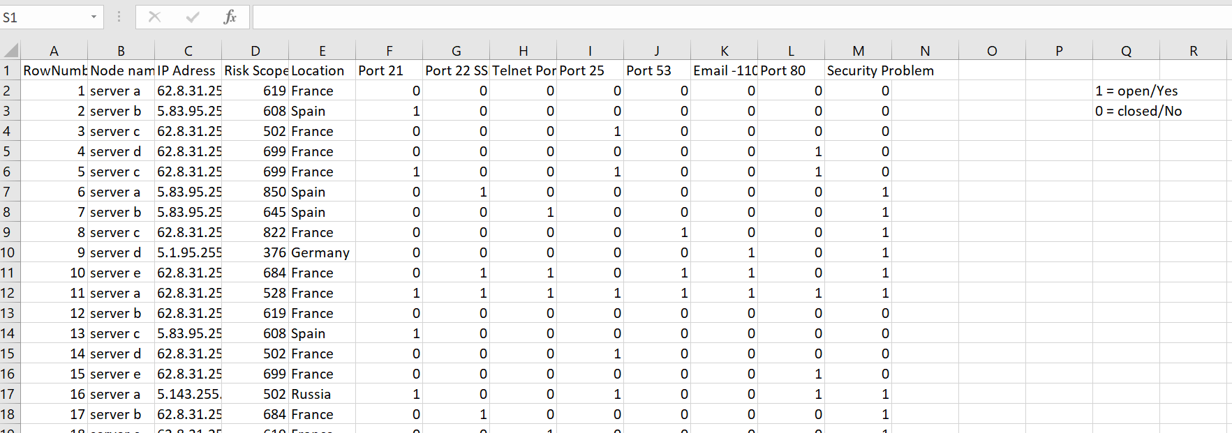
Example – Prediction if a Server is at risk to a cyber attack

Slide 57
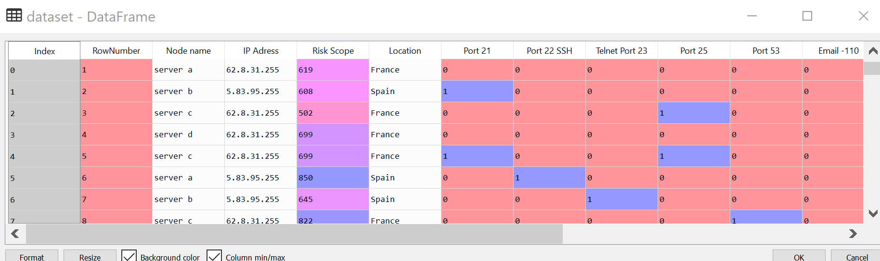
Read into a Data Frame

Slide 58

Data Transformation – Computer can only read Numbers x = independent variables

Slide 59

Y= Dependent Variables

Slide 60

Confusion Matrix

Slide 61

Weaponizing AI

Slide 62

Weaponizing AI

Slide 63

Weaponizing AI

